Slide 1
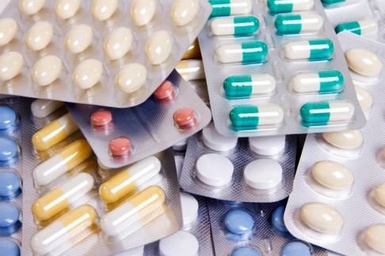


PHARMACY MANAGEMENT SYSTEM
GROUP-3S
M.Kaushik - 2014csc010
S.Jathurshan – 2014csc003
A.Tharshikan – 2014csc036
C.Lahiru - 2014csc034
S.Thilakarathna - 2014csc030
Mentor – Dr A. Ramanan

Slide 2

Aim:-
Providing the customer a efficient way of storing the medicine data.
Providing the customer a efficient billing system.

Slide 3


Technologies Used:-
We used C# as our programming language and Visual Studio as the platform.
We used SQL Server for developing the database.
www.google.lk

Slide 4
Functional Requirements
•Generates report weekly on information about the drugs and it exports the information as output document.
• Stores the detail information about each medicine including actual name, formula of medicine and for which diseases is required.
•When the user search the item on search bar the related things were displayed in the screen and can select the actual item that the user needs.
•Give an alert message when the medicine outdated.
•Give an alert for the user when medicine item is low.
•Prepare bill for the medicine.
•Managing the stocks.
•Expiry date alert will come to the system.

Slide 5
Non-Functional requirements
• It has the instruction menu to explain users about how to use it.
• It is available based on the user needs ( work properly, do transactions efficiently including safe data management of the pharmacy)
• Pharmacy system is password protected to change things on the system.
• Data is protected and controlled by the administrator.
• The owner can handle all the data without any permission.

Slide 6
Challenges Faced:-
Searching for a pharmacy.
Programming language.
Not getting the requirements on time.

Slide 7
App Group3S
Demonstration…….

Slide 8

Questions & Answers:

